Slide 1

UNIT 1 Introduction – Database Management Systems

Slide 2
Data:
Data is collection of raw facts typically about physical phenomena or business transactions.
Data can be in any form-numerical, textual, graphical, image, sound, video etc.
For example of data would be the marks obtained by students in different subjects.

Slide 3
Information:
Information is defined as refined or processed data that has been transformed into meaningful and useful form for specific users.
For example, after processing the marks obtained by student it transformed into information, which is meaningful and from which we can decide which student stood first, second and so forth. Information comes from data and takes the form of table, graphs, diagrams etc.

Slide 4
Database:
A database is an organized collection of data and contains information relevant to an enterprise.
The database is also called the repository or container for a collection of data files.
For example, university database for maintaining information about students, courses and grades in university.

Slide 5
Characteristics of data in database:
The data in a database should have the following features:
Shared: Data should be sharable among different users and applications.
Persistence: Data should exist permanently in the database. Changes in the database must not be lost because of any failure.
Validity/Integrity/Correctness: It should maintain the integrity so that there is always correct data in the database.
Security: Data should be protected from unauthorized access.

Slide 6
Non-redundancy: Data should not be repeated.
Consistency: A consistent state of the database satisfies all the constraints specified in the database. Data in a database is consistent if any changes in the database take the database from one consistent state to another.

Slide 7
Database Management System:
A Database Management System (DBMS) is a collection of interrelated data and the set of programs to access those data. The primary goal of a DBMS is to provide a way to store and retrieve database information that is both convenient and efficient.
Some common examples of the DBMS software are Oracle, Sybase, Microsoft SQL Server, DB2, MySQL, Postgres, Dbase, Ms-Access etc.
For example, in a computer system, the checking account processing system, the auto loan system and the saving accounts would have a common database. This database based approach to data processing is shown in fig below

Slide 8
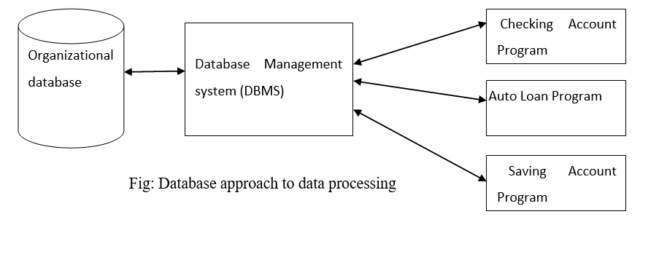

Slide 9
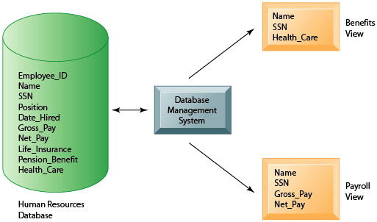
Example:

Slide 10
Objective of DBMS
The DBMS is able
To provide large space or storage for relevant data.
To provide easy access to the data for the users.
To provide quick response to user request for any data.
To remove duplicate (redundant) data.
To update the database latest modification immediately.
To allow the multiple users to be active at one time.
As the organization grows, DBMS allows the growth of the database system.
To provide maximum protection to data from any physical damage and unauthorized access.

Slide 11
Applications of DBMS:
Databases form an essential part of almost all enterprises. Some database applications are given below:
Banking: For customer information and all transactions
Airlines: For reservations and schedules information
Universities: For the student information, course registration and grades
Credit and transaction: For purchase credit cards and generates monthly statement
Telecommunication: Keeping records of all the telephone calls, generating monthly bills etc.
Finance: For storing financial information
Sales: For customers, products and purchases information
Manufacturing: For tracking production, inventory, orders, supply chain management
Human resources: For storing the information about employee records, salaries, tax deductions

Slide 12
Disadvantages of DBMS
Problem associated with centralization: Centralization increases the security problems.
Cost of software: Today’s there are several softwares which are very costly. Hence from economic point of view it is the drawback.
Cost of hardware: To support various software some upgraded hardware components are needed. Hence from economic point of view it is the drawback.
Complexity of backup and recovery: DBMS provides the centralization of the data, which requires the adequate backups of data.
Overhead for providing generality, security, recovery, integrity, and concurrency control.

Slide 13
Question 1:
Define Data, Information, Database and Database Management System(DBMS). And also Explain why DBMS is so important nowadays? You can explain with examples.

Slide 14
File Systems:
A file system is a technique of arranging the files in a storage medium like a hard disk, pen drive, DVD, etc. It helps you to organizes the data and allows easy retrieval of files when they are required. It mostly consists of different types of files like mp3, mp4, txt, doc, etc. that are grouped into directories.
A file system enables you to handle the way of reading and writing data to the storage medium. It is directly installed into the computer with the Operating systems such as Windows
For example, in a computer system, the checking account processing system would have its own data files. This file based approach to data processing is shown in fig below:
For more information: https://www.javatpoint.com/dbms-vs-files-system

Slide 15
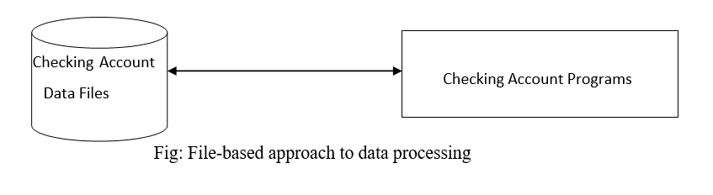

Slide 16
Limitations of File System:
Keeping organizational information in a file-processing system has a number of major disadvantages:
Data redundancy
Data inconsistency
Difficulty in accessing data by multi user
Data isolation
Integrity problems
Security problems
For more information: https://beginnersbook.com/2015/04/dbms-vs-file-system/?fbclid=IwAR2k5L1_2wrgJgThwA9P9XeqigqydOY3lQgLF-0Jxdv_ZPboeMv3gKtGXUM

Slide 17
Data Abstraction
Data Abstraction is a process of hiding unwanted or irrelevant details from the end user. It provides a different view and helps in achieving data independence which is used to enhance the security of data.
The database systems consist of complicated data structures and relations. For users to access the data easily, these complications are kept hidden, and only the relevant part of the database is made accessible to the users through data abstraction.

Slide 18
Levels of Data Abstraction:
Database systems include complex data-structures. In terms of retrieval of data, reduce complexity in terms of usability of users and in order to make the system efficient, developers use levels of abstraction that hide irrelevant details from the users. Levels of abstraction simplify database design.
Mainly there are three levels of abstraction for DBMS, which are as follows −
Physical or Internal Level
Logical or Conceptual Level
View or External Level

Slide 19
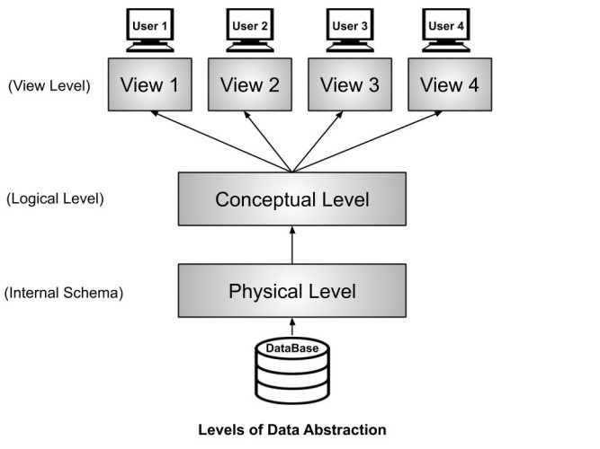
Levels of Data Abstraction:
The three levels of data abstraction can be shown as follows:

Slide 20
Question 2:
Differentiate between File system and DBMS.
What is Data Abstraction? Explain three level of data abstraction with proper figure.

Slide 21
Database Models:
A database model shows the logical structure of a database, including the relationships and constraints that determine how data can be stored and accessed.
Individual database models are designed based on the rules and concepts of whichever broader data model the designers adopt. Most data models can be represented by an accompanying database diagram.
For more info: https://www.lucidchart.com/pages/database-diagram/database-models?fbclid=IwAR32Q9KZtnAiP3EFparKgdcdNK0-zuxtlXx4XZIwgKB9AidCXBU4qIucibI

Slide 22
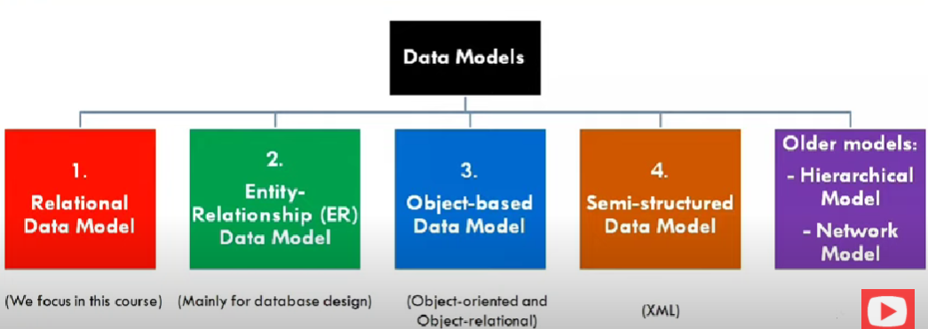

Slide 23
Entity- Relationship Model:
The E-R data models is based on a perception of real world that consist of a collection of basic objects called entities and relationship among these objects. In an E-R model a database can be modeled as a collection of entities, and relationship among entities.
Overall logical structure of a database can be expressed graphically by E-R diagram. The basic components of this diagram are:
Rectangles (represent entity sets)
Ellipses (represent attributes)
Diamonds (represent relationship sets among entity sets)
Lines (link attributes to entity sets and entity sets to relationship sets)

Slide 24
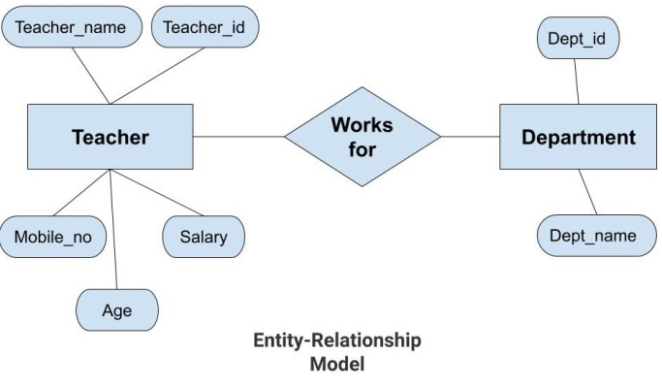

Slide 25
Relational Model:
The relational model is a lower level model that uses a collection of tables to represent both data and relationships among those data. Each table has multiple columns, and each column has a unique name.
Each table corresponds to an entity set or relationship set, and each row represents an instance of that entity set or relationship set. Structured query language (SQL) is used to manipulate data stored in tables.

Slide 26
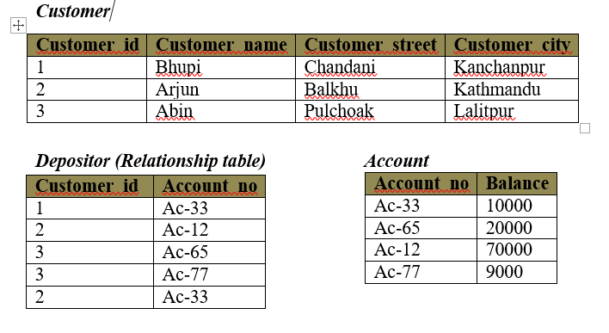

Slide 27
Object oriented data model:
The object oriented data model is based on object-oriented programming paradigm. It is based on the concept of encapsulating the data and the functions that operate on those data in a single unit called an object. The internal parts of objects are not visible externally.
Here one object communicates with other objects by sending message.

Slide 28
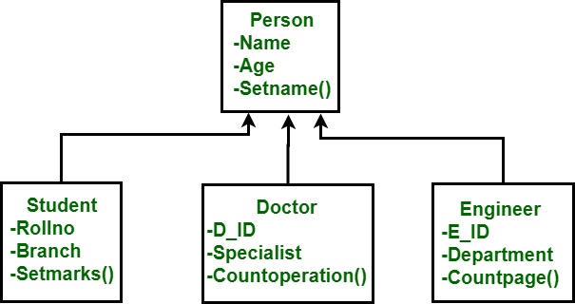

Slide 29
Hierarchical data model:
In a hierarchical data model, the data elements are linked in the form of an inverted tree structure with the root at the top and the branches formed below.
Below the single root data element are subordinate elements, each of which, in turn, has one or more other elements. There is a parent child relationship among the data elements of a hierarchical database.
There may be many child elements under each parent element, but there can be only one parent element for any child element. The branches in the tree are not connected.

Slide 30
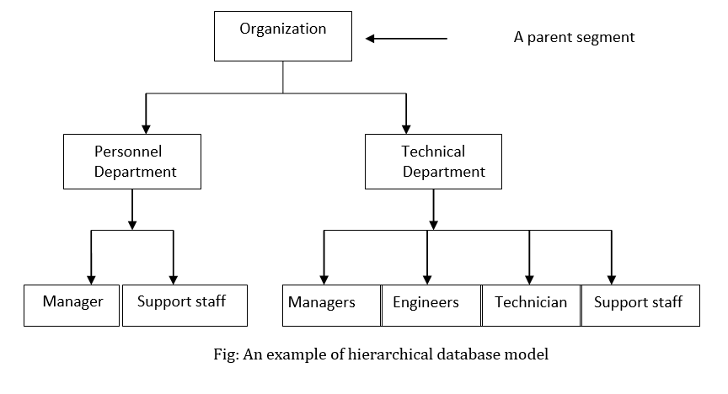

Slide 31
Network Data Model:
A network data model is an extension of the hierarchical database structure. In this model also, the data elements of a database are organized in the form of parent-child relationships and all types of relationships among the data elements must be determined when the database is first designed.
In a network database, a child data element can have more than one parent element or no parent at all. Moreover, in this type of database, the database management system permits the extraction of the needed information from any data element in the database structure, instead of starting from the root data element.

Slide 32
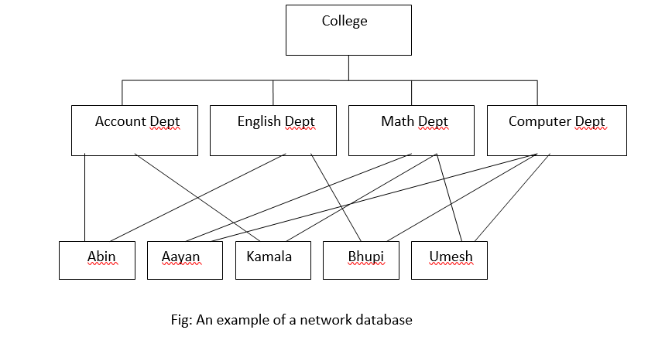

Slide 33
Question 3:
What is Data Models? Explain the types of data models with proper figure.

Slide 34
Instance (Database State):
The collection of information stored in the database at a particular moment is called an instance of the database. It is the actual content of the database at a particular point in time.
The term instance is also applied to individual database components, e.g. record instance, table instance etc.
Initial Database State
Refers to the database state when it is initially loaded into the system.
Valid State
A state that satisfies the structure and constraints of the database.

Slide 35
Schema:
The overall design of the database which is not expected to change frequently is called database schema. Simply, the database schema is the logical structure and design of the database including table and relationship.
The concept of database schema can be understood by logic to a program written in a programming language
The database systems have several schemas and partitioned according to the level of abstraction such as physical and logical schema.

Slide 36
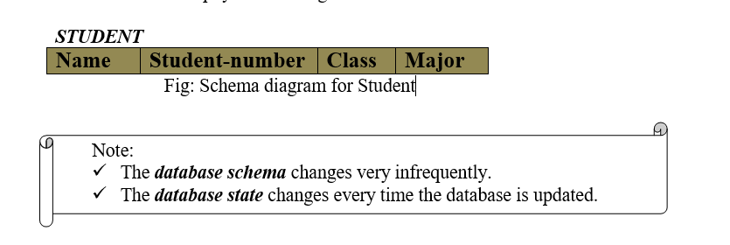

Slide 37
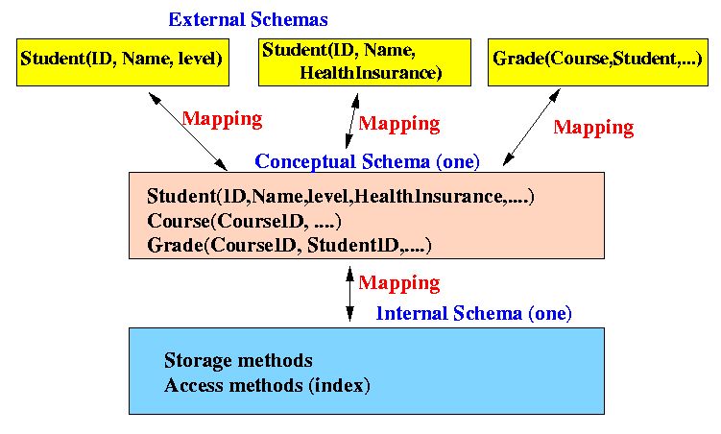
Three level of Schema

Slide 38
Data Independence:
The three schema architecture further explains the concept of data independence, the capacity to change the schema at one level without having to change the schema at the next higher level.
Logical Data Independence
Physical Data Independence
Logical Data Independence:
The capacity to change the conceptual schema without having to change the external schemas and their associated application programs is called logical data independence. When modification is done to the conceptual schema (i.e tables) the mapping called “external mapping” is changes automatically by DBMS.

Slide 39
Physical Data Independence:
The capacity to change the internal schema without having to change the conceptual schema is called physical data independence. When a schema at a lower level is changed, only the mappings between this schema and higher-level schemas need to be changed in a DBMS. This mapping is called “logical mapping”.
For example, the internal schema may be changed when certain file structures are reorganized or new indexes are created to improve database performance.

Slide 40
Database users and administrators
Database users:
Users are differentiated by the way they expect to interact with the system. There are four different types of database-system users:
Naive Users: They are unsophisticated users who interact with the system by invoking one of the application programs that have been written previously. For example: a bank teller who needs to transfer $50 from account A to account B invokes a program called transfer.
Application programmers: They are computer professionals who write application programs. Application programmers can choose any tools to develop user interface.
Sophisticated users: They interact with the system without writing programs. They form their requests in a database query language.
Specialized users: They are sophisticated users who write specialized database applications that do not fit into the traditional data-processing framework. Among these applications are computer-aided design systems, knowledge base and expert systems, systems that store data with complex data types (graphics data and audio data), and environment-modeling systems.

Slide 41
Database Administrator:
The person who has such central control over the system is called the database administrator (DBA). The function of the DBA includes the following:
Schema definition: The DBA creates the original database schema by writing a set of definitions that is translated by the DDL compiler to a set of tables that is stored permanently in the data dictionary.
Granting the authorization of data access: The granting of different types of privileges to the database users so that all the users are not able to all data.
Routine maintenance: Routine maintenance includes periodic backing up the database, either onto tapes or onto remote servers, to prevent loss of data in case of disasters such as flooding, Ensuring that enough free disk space is available for normal operations, and upgrading disk space as required etc.

Slide 42
Question 4:
Define Instances(Database State), Schema and Data Independence.
What is database users and administrator ?

Slide 43
DBMS Architecture
The DBMS design depends upon its architecture. The basic client/server architecture is used to deal with a large number of PCs, web servers, database servers and other components that are connected with networks.
The client/server architecture consists of many PCs and a workstation which are connected via the network.
DBMS architecture depends upon how users are connected to the database to get their request done.

Slide 44
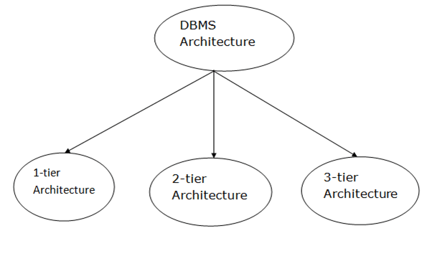
Types of DBMS Architecture

Slide 45
1-Tier Architecture
In this architecture, the database is directly available to the user. It means the user can directly sit on the DBMS and uses it.
Any changes done here will directly be done on the database itself. It doesn't provide a handy tool for end users.
The 1-Tier architecture is used for development of the local application, where programmers can directly communicate with the database for the quick response.

Slide 46
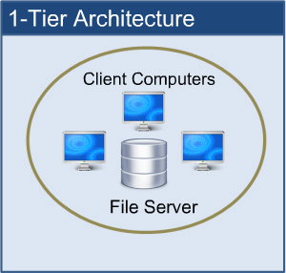

Slide 47
2-Tier Architecture
The 2-Tier architecture is same as basic client-server. In the two-tier architecture, applications on the client end can directly communicate with the database at the server side. For this interaction, API's like: ODBC, JDBC are used.
The user interfaces and application programs are run on the client-side.
The server side is responsible to provide the functionalities like: query processing and transaction management.
To communicate with the DBMS, client-side application establishes a connection with the server side.

Slide 48
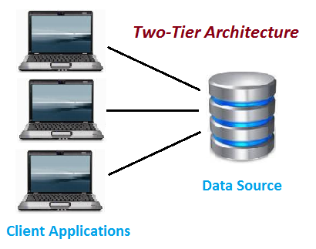
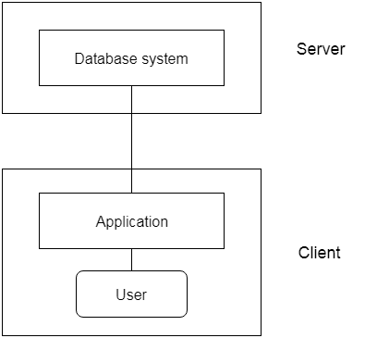

Slide 49
3-Tier Architecture
The 3-Tier architecture contains another layer between the client and server. In this architecture, client can't directly communicate with the server.
The application on the client-end interacts with an application server which further communicates with the database system.
End user has no idea about the existence of the database beyond the application server. The database also has no idea about any other user beyond the application.
The 3-Tier architecture is used in case of large web application

Slide 50
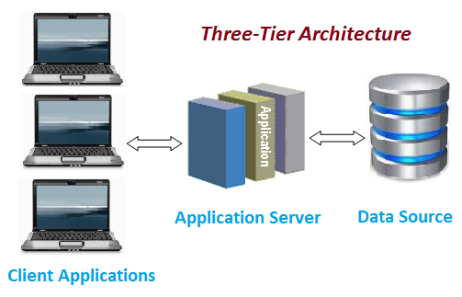
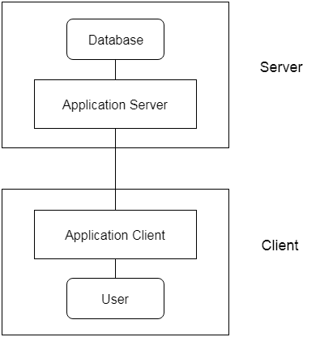

Slide 51
Database System Structure
DBMS (Database Management System) acts as an interface between the user and the database. The user requests the DBMS to perform various operations such as insert, delete, update and retrieval on the database.
The components of DBMS perform these requested operations on the database and provide necessary data to the users.
For detailed information visit this link:
https://www.tutorialcup.com/dbms/structure-of-dbms.htm?fbclid=IwAR3jdf0elVX2VWqovEnnja5sxu7fHUAy3MrQaamkpEj-_e4D9DkOv7vx750

Slide 52
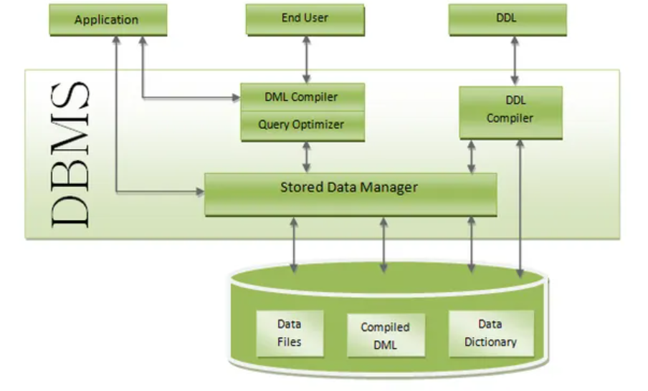
Database System Structure and its components:

Slide 53
Question 5:
What is DBMS Architecture? Explain type of DBMS architecture with proper figure and example.
Define DBMS system structure and their components?

Slide 54
Database Interfaces
A database management system (DBMS) interface is a user interface that allows for the ability to input queries to a database without using the query language itself. User-friendly interfaces provided by DBMS may include the following:
Menu-Based Interfaces
These interfaces present the user with lists of options (called menus) that lead the user through the formation of a request. The basic advantage of using menus is that they remove the tension of remembering specific commands and syntax of any query language. The query is basically composed step by step by collecting or picking options from a menu that is shown by the system. Pull-down menus are a very popular technique in Web-based interfaces. They are also often used in browsing interfaces which allow a user to look through the contents of a database in an exploratory and unstructured manner.
Forms-Based Interfaces
A forms-based interface displays a form to each user. Users can fill out all of the form entries to insert new data, or they can fill out only certain entries, in which case the DBMS will redeem the same type of data for other remaining entries. These types of forms are usually designed or created and programmed for users that have no expertise in operating systems. Many DBMS's have form specification languages which are special languages that help specify such forms. Example: SQL Forms is a form-based language that specifies queries using a form designed in conjunction with the relational database schema.

Slide 55
Database Interfaces
Graphical User Interface
A GUI typically displays a schema to the user in diagrammatic form. The user then can specify a query by manipulating the diagram. In many cases, GUI utilize both menus and forms. Most GUI use a pointing device such as a mouse, to pick a certain part of the displayed schema diagram.
Natural Language Interfaces
These interfaces accept requests written in English or some other language and attempt to understand them. A Natural language interface has its own schema, which is similar to the database conceptual schema as well as a dictionary of important words.
The natural language interface refers to the words in its schema as well as to the set of standard words in a dictionary to interpret the request. If the interpretation is successful, the interface generates a high-level query corresponding to the natural language and submits it to the DBMS for processing, otherwise, a dialogue is started with the user to clarify any provided condition or request. The main disadvantage of this is that the capabilities of this type of interface are not that advance.

Slide 56
Database Interfaces
Speech Input and Output Interfaces
There is limited use of speech be it for a query or an answer to a question or being a result of a request it is becoming commonplace. Applications with limited vocabulary such as inquiries for telephone directory, flight arrival/departure, and bank account information are allowed speech for input and output to enable ordinary folks to access this information.
The Speech input is detected using predefined words and used to set up the parameters that are supplied to the queries. For output, a similar conversion from text or numbers into speech takes place.
Interface for Parametric Users
Interfaces for Parametric Users contain some commands that can be handled with a minimum of keystrokes. It is generally used in bank transactions for transferring money. These operations are performed repeatedly.
Interfaces for Database Administrators (DBA)
Most database system contains privileged commands that can be used only by the DBA's staff. These include commands for creating accounts, setting system parameters, granting account authorization, changing a schema, and reorganizing the storage structures of databases.

Slide 57
Database Environment
A database environment is a collective system of components that comprise and regulates the group of data, management, and use of data, which consist of software, hardware, people, techniques of handling database, and the data also.
Here, the hardware in a database environment means the computers and computer peripherals that are being used to manage a database, and the software means the whole thing right from the operating system (OS) to the application programs that include database management software like M.S. Access or SQL Server. Again the people in a database environment include those people who administrate and use the system. The techniques are the rules, concepts, and instructions given to both the people and the software along with the data with the group of facts and information positioned within the database environment.

Slide 58
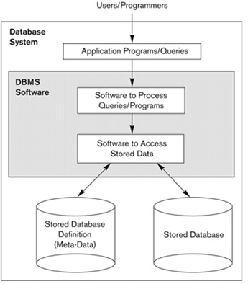
Database Environment

Slide 59
Database Languages
DDL
DML
DCL
Assignment

